Slide 1
Chest Game
By
Guoying Li, Cheng Su

Slide 2

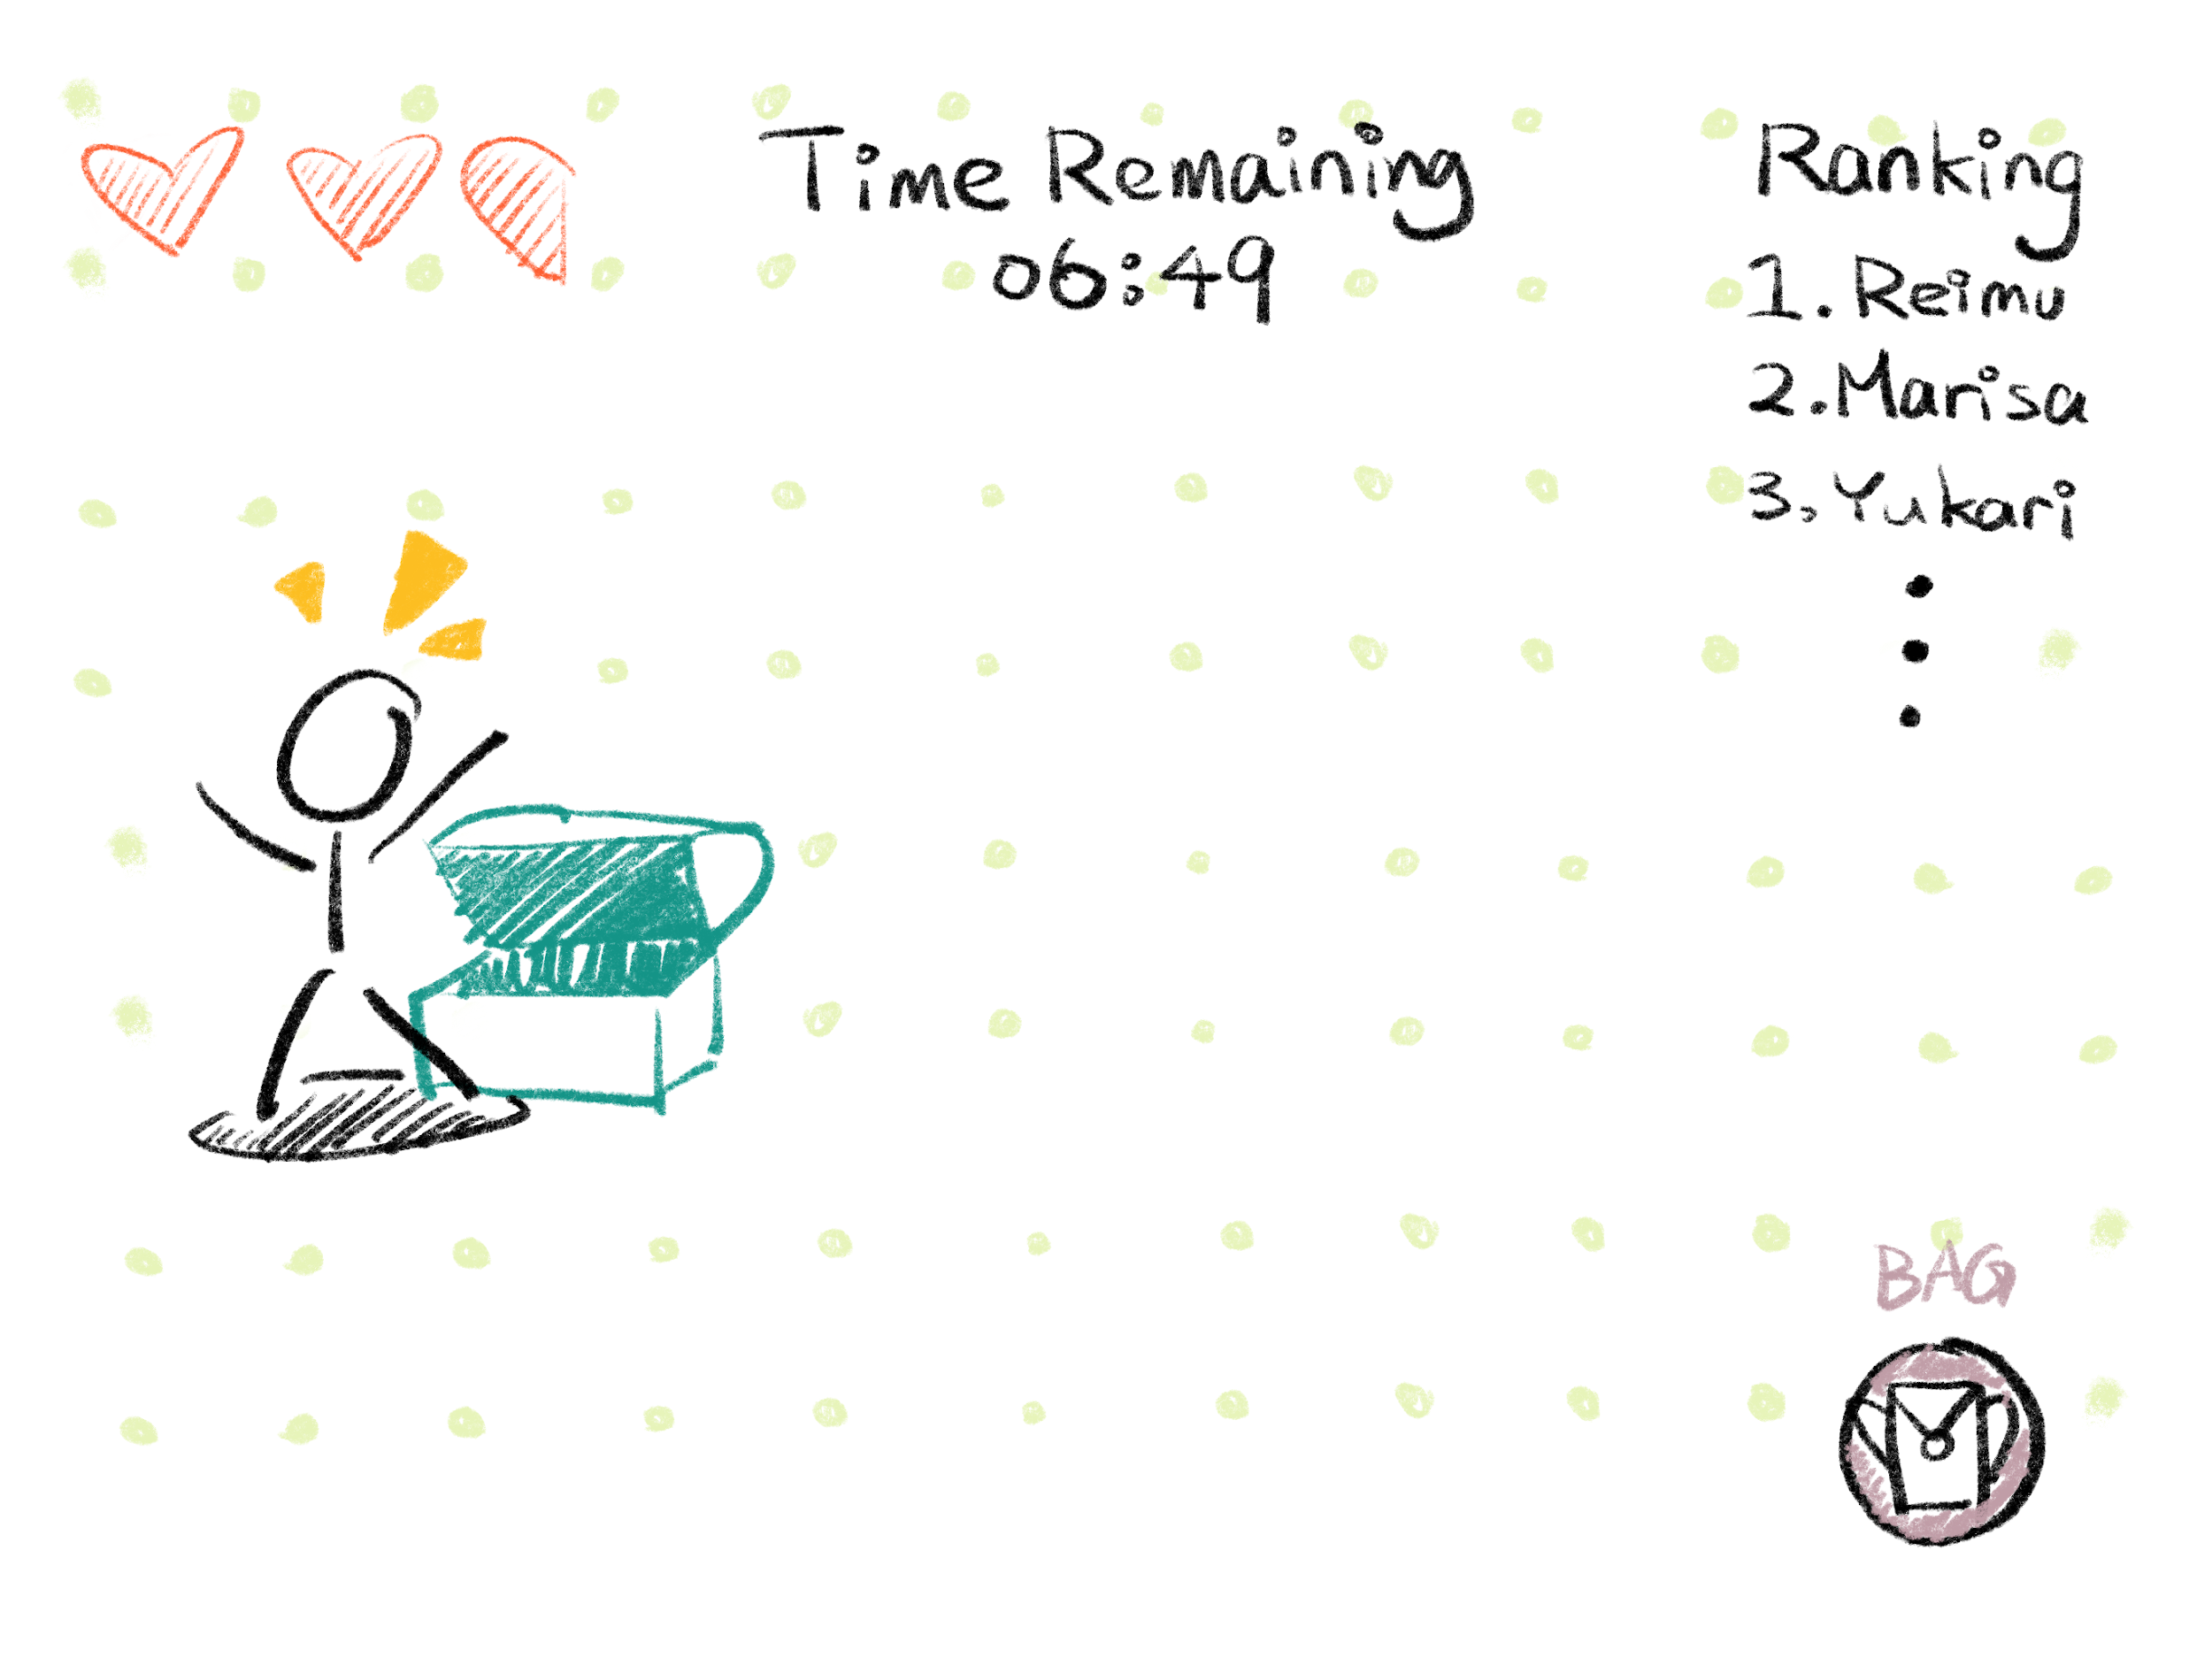
LET`S DO AN OVERVIEW
Basic Game Mechanism & Marketing

Slide 3
PROBLEMS
Three of main questions are:
How to store and deal with in-game data
How to store past data and analyze players’ performance
How to evaluate the performance of a specific marketing strategy.

Slide 4
SOLUTIONS
(Mechanism & Player) create a database supporting the game.
(Marketing Performance) To Evaluate the performance of a specific marketing strategy, we will analyze the data, including the KPIs (the increasing number of players) at each level.

Slide 5
MODEL - OUTLINE
Game Mechanism
Core Mechanism
Loot and Items
Player
Map
UI Display
Marketing and Data Analysis
Marketing strategies
KPI
Player Archive Table

Slide 6
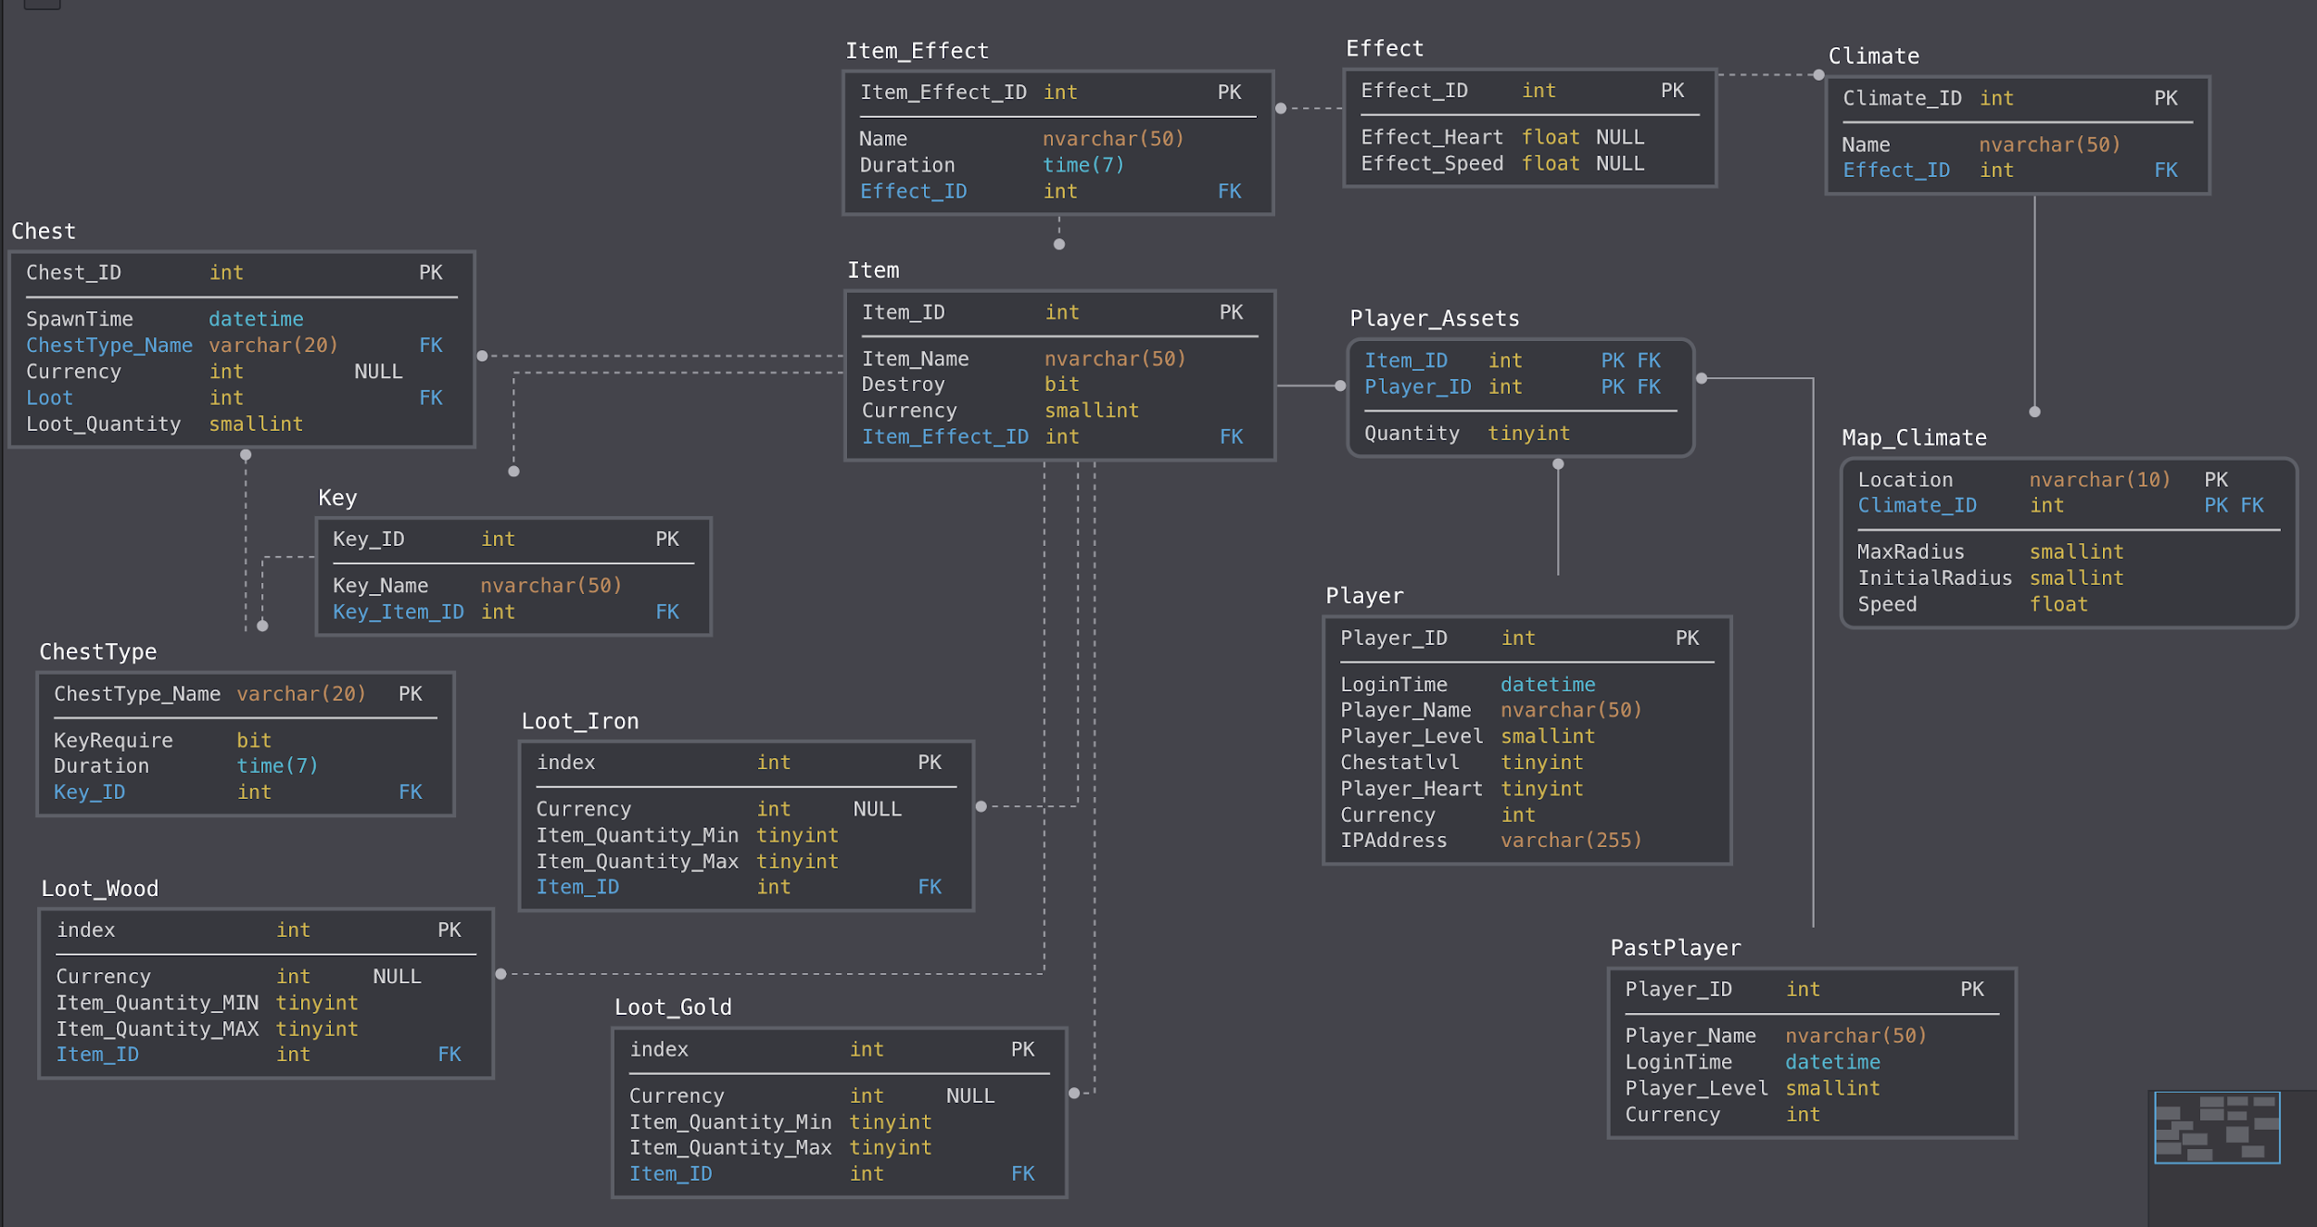
DATA FLOW

Slide 7
DATA FLOW
Player
-> PlayerAsset
ChestType
-> Chest
Item -> Loot_Wood/Iron/Gold

Slide 8
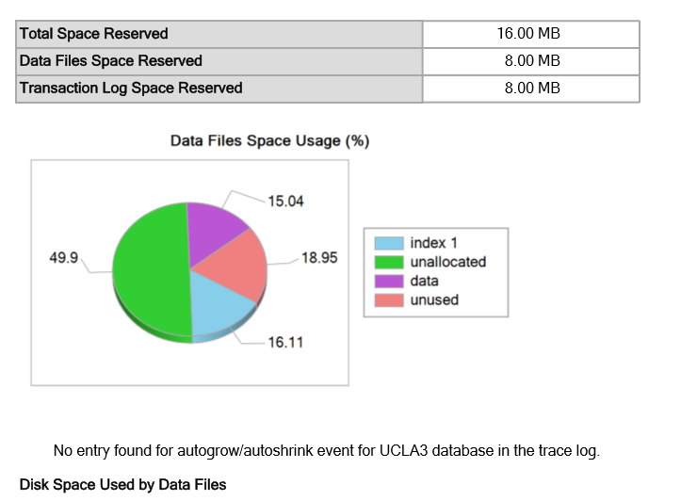
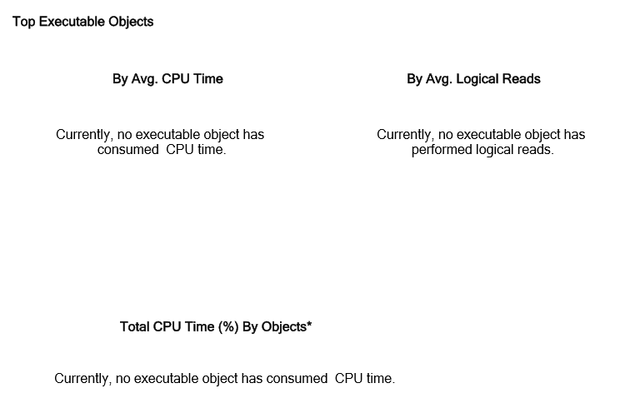
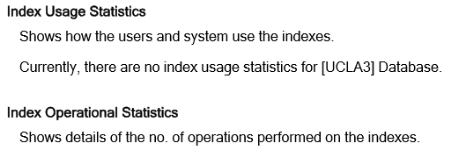
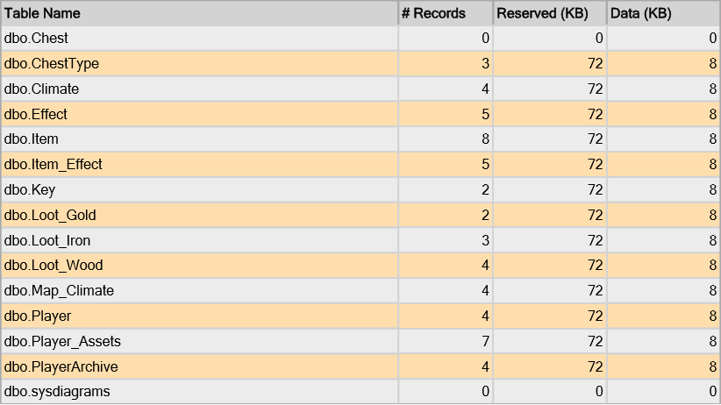
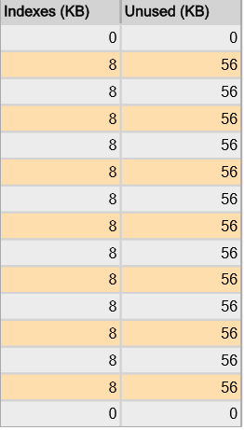
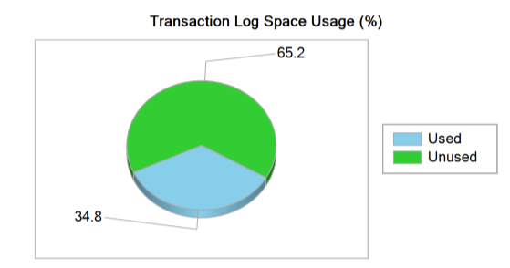
JOINS AND QUERIES
We got some solutions
show queries as pictures

Slide 9
NORMALIZE AND DENORMALIZE
Player & Player Assets
Item, Item Effect and Loot tables
Chest & ChestType
Climate & Map

Slide 10
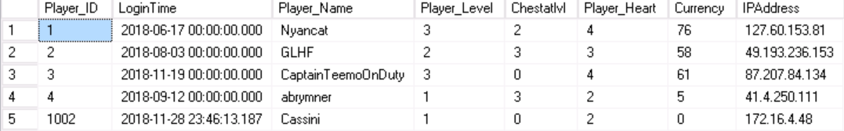
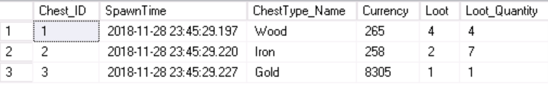
Joins and Queries
Create player
Create chest
Item of a number(in a range) + money, all generated randomly
Create PlayerArchive
Create KPIMarketingStrategy

Slide 11
Security & Auditing
We remove players of more than a months ago from player table, and put them into archive table.
Prevent delete action if those player’s are not past players.

Slide 12
PERFORMANCE IMPROVEMENT CONCERNS
Cluster constraints added for primary keys
Inactive Players(heartbeat)
Flow Control
Unstable Connection

Slide 13
Future

Slide 14
FUTURE OF AN IDEA
1. Social, integrate with other software
Integrate with other login systems, eg. gmail, facebook, wechat, line, kakaotalk
Games with friends instead of alone, social, real-time, real location.
Example: climate in this game is related to their real location (los angeles- hot; new york- cold; otherwise, mild; this is simple but real fun design at this stage.
2. Real time & locations
In the future, locations may be real, eg, shopping mall, parks, flight; rewards may be real as well, such as coupon for shopping.
Example/application: shopping instruction/map before or during flights, users can spend their time shopping and gaming in their spare time.

Slide 15
THANKS!
Any questions?

